Slide 1

Smart Office System
Automated smart office
Course Title : Computer network Lab
Course code : CSE - 312

Slide 2

Presented By Md. Torikul Islam
ID: 192002131
Section: DB
Presented To Mr. Palash Roy
Lecturer
Department : CSE
Green University of Bangladesh

Slide 3
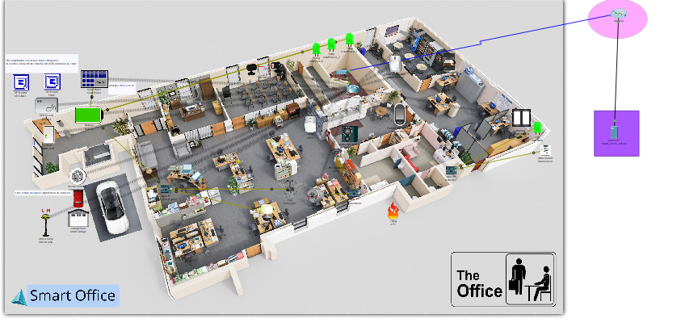
Video slide
Project Features:

Slide 4
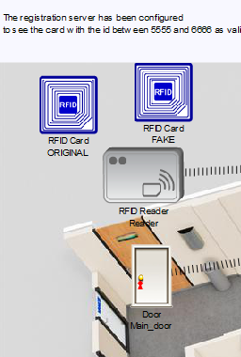
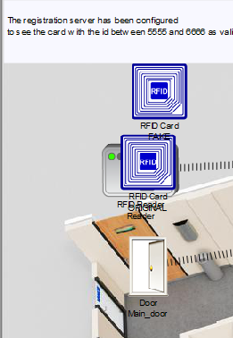
1.RFID based Door Lock

Slide 5
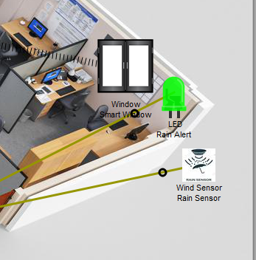
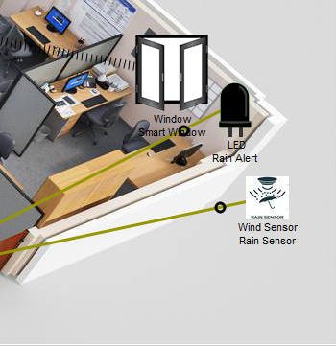
2.Smart Window

Slide 6
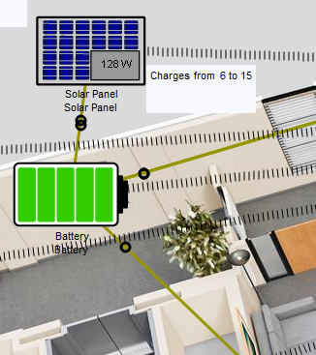
3.Solar Battery Charging

Slide 7
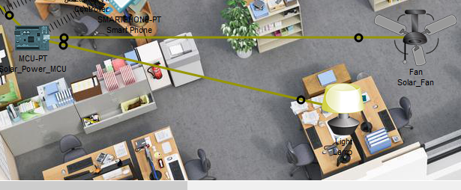
3.Solar Battery Charging

Slide 8
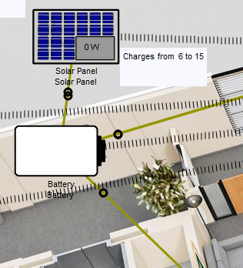
3.Solar Battery Charging

Slide 9
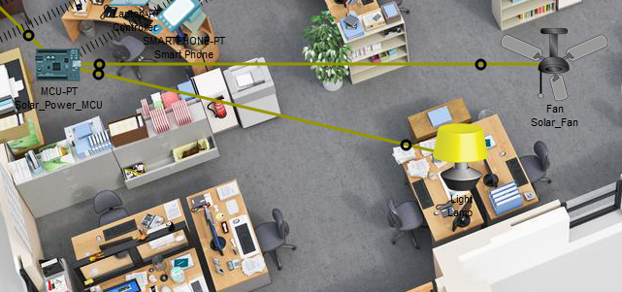
3.Solar Battery Charging

Slide 10
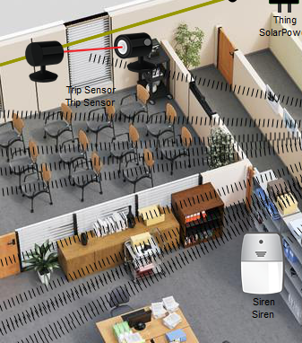
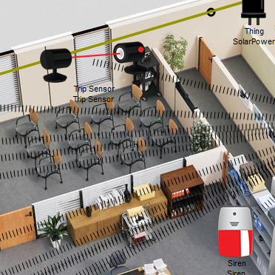
4.Anti-Theft protection

Slide 11
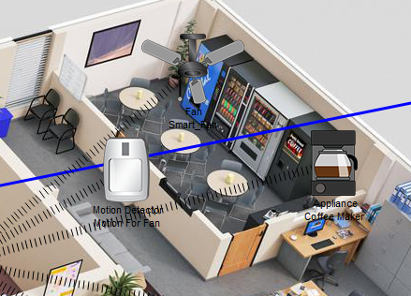
5.Auto fan and coffee maker

Slide 12
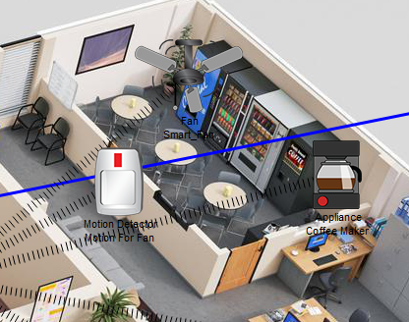
5.Auto fan and coffee maker

Slide 13
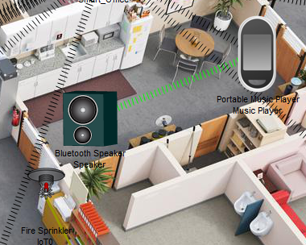
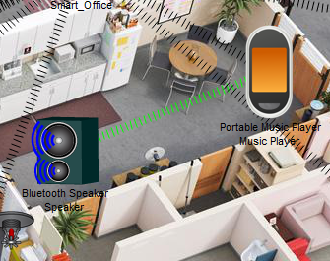
6.Music Player

Slide 14
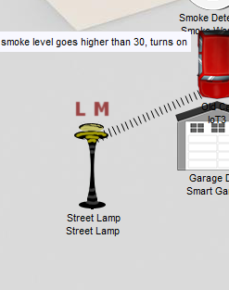
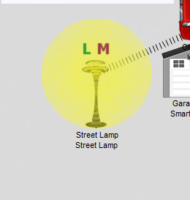
7.Smart Street Lamp

Slide 15
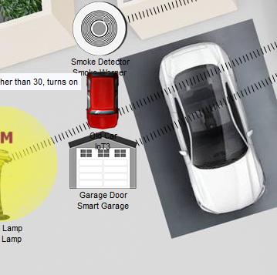
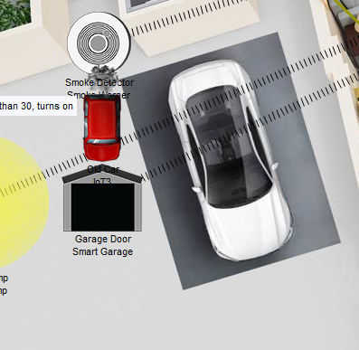
8.Smart Garage

Slide 16
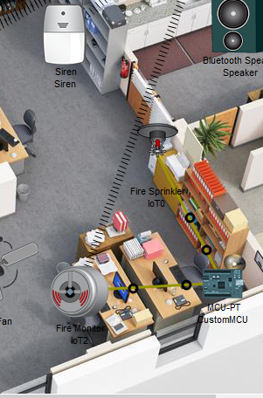
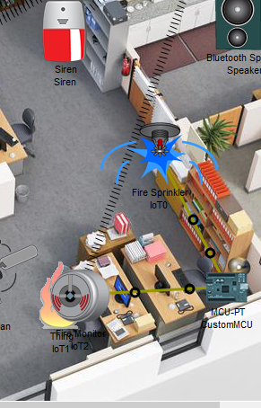
9.Fire/Smoke Alarm

Slide 17
Thanks!

